Slide 1

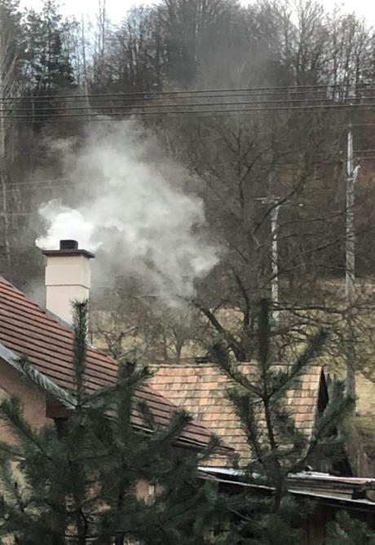
Indoor air pollution from wood stoves
Kaare Press-Kristensen
M.Sc. in engineering, Ph.D.
Senior advisor on air quality
Healthy Indoor Environment
kaare@godtindeklima.nu
www.healthyindoorenvironment.org

Slide 2

About this presentation
The aim of this presentation is to inform about the risk of health hazardous indoor air pollution from wood stoves. You’ll find a few slides on outdoor air pollution at the end.
You can use some - or all - slides from this presentation without permission. Please acknowledge the source.
Our work to limit pollution from residential wood burning was originally (2023-24) funded by:

Slide 3
Who are we?
Healthy Indoor Environment was founded in 2023 to help people achieve a better indoor environment by collecting existing knowledge, create new knowledge and inform on ways to better indoor environment.
Healthy Indoor Environment is a Danish non-profit NGO with an international focus.
Our staff are engineers and biochemists. Our board are mainly university professors.

Slide 4
Indoor particle pollution
Teis Nørgaard Mikkelsen
Associate Professor at DTU Sustain
Technical University of Denmark
“Our measurements show that wood stoves can pollute the indoor air in homes with higher numbers of toxic particles than what is measured from traffic on the busiest streets in Copenhagen during rush hour. This applies regardless of whether your stove is new or old.”

Slide 5
Health effects
Torben Sigsgaard, Professor
Department of Public Health
Aarhus University
“Wood smoke contains many of the same toxic compounds as tobacco smoke. The pollution increases the risk of cancer, blood clots, cardiovascular diseases, COPD, bronchitis and asthma.”

Slide 6
Vulnerable children
Marie Pedersen, Assistant Professor
Department of Public Health
University of Copenhagen
“20% of all pre-school children have asthma, while 10% of all school-children have asthma. Asthma is the most frequent reason for children to be hospitalized. My research shows that children are particularly sensitive to particle pollution. Therefore, indoor air pollution should be avoided.”

Slide 7
Health costs
Zorana Jovanovic Andersen, Professor
Department of Public Health
University of Copenhagen
“Wood smoke in outdoor air is the largest Danish source to health hazardous air pollution. It contains toxic particles as well as carcinogenic tar substances and dioxins. The pollution causes approx. 300 premature deaths, serious illness and health costs of around 0.7 billion euro every year in Denmark.”

Slide 8
Solutions
Kaare Press-Kristensen, Senior Advisor
Healthy Indoor Environment
“Smoke-free heating is the way forward. District heating in cities and heat pumps in the countryside. This will provide both a better indoor climate as well as reduced pollution in our residential areas. The coziness can easily be maintained with an electric fireplace or a TV fireplace.”

Slide 9
Wood smoke and health
Wood smoke contains the same carcinogenic and health hazardous particles and PAHs as tobacco smoke – and dioxins in regions close to the sea.
Wood smoke increases the risk of cardiovascular diseases, cancer, serious lung diseases, etc.
More on health effects: https://www.dsawsp.org/health
WHO: https://www.youtube.com/watch?v=GVBeY1jSG9Y

Slide 10
Indoor air pollution
Wood stoves are placed inside homes and can emit pollution directly to indoor air where it can spread to the entire house (bedrooms, children's room, etc.).
Wood stoves are mainly used in seasons where we ventilate less and while families are at home i.e., people can be exposed to very high levels of air pollution for many hours in their homes.
There is no regulation limiting how much wood stoves can pollute the indoor environment.

Slide 11
Cause of the pollution
The pollution origins:
- From the wood stove when adding firewood.
- From leaky stoves and chimney pipes.
- From dust burned on hot surfaces of the stove.
Nothing indicates that good new stoves cause less indoor air pollution than older stoves.
Residents themselves do not smell the pollution → Residents are unaware of the health risk!

Slide 12
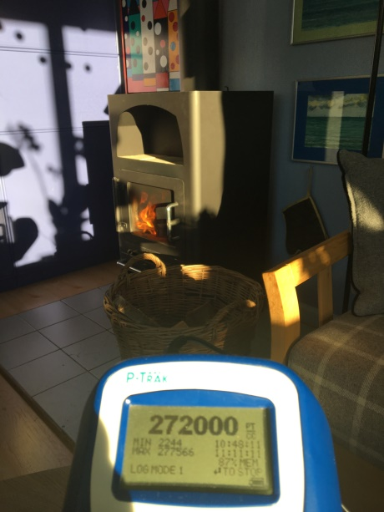
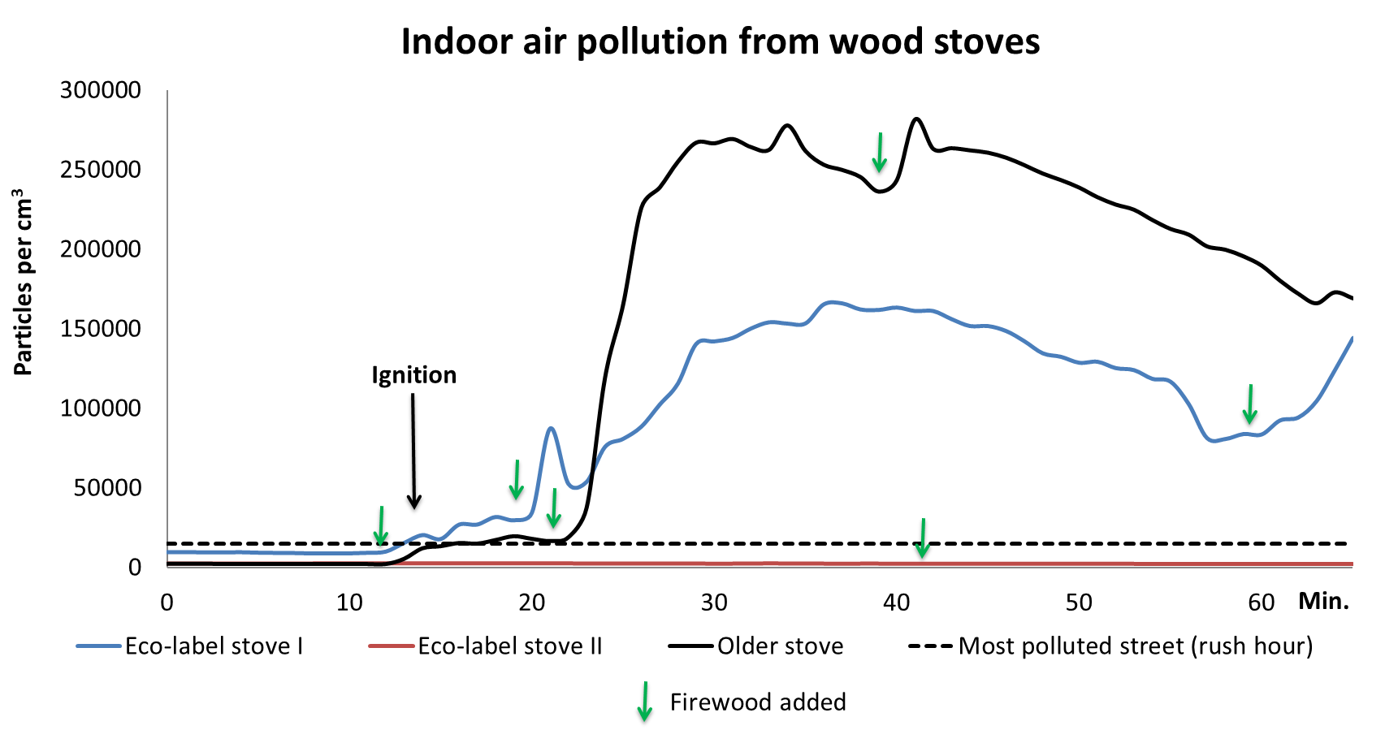
Indoor air pollution
Some (but not all) wood stoves emit smoke directly inside homes and thereby increase indoor air pollution.

Slide 13
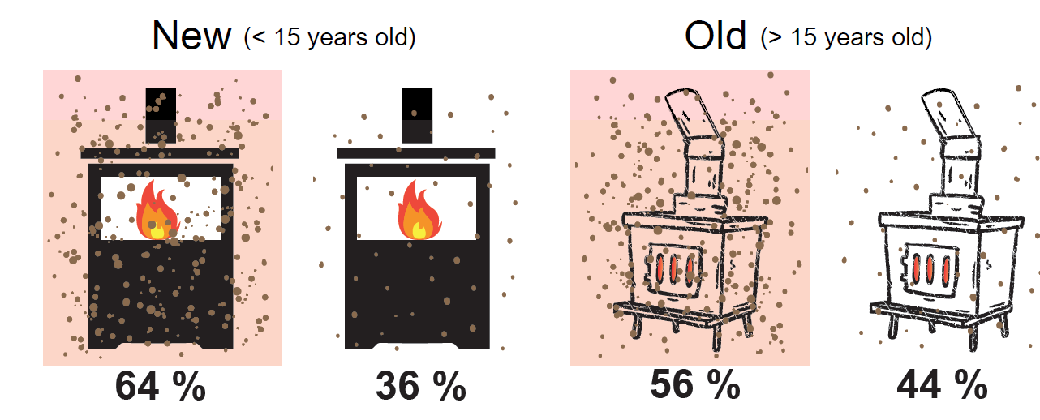
DTU: Old versus new wood stoves
Source: Teis Nørgaard Mikkelsen
Associate Professor at DTU Sustain
Technical University of Denmark

Slide 14
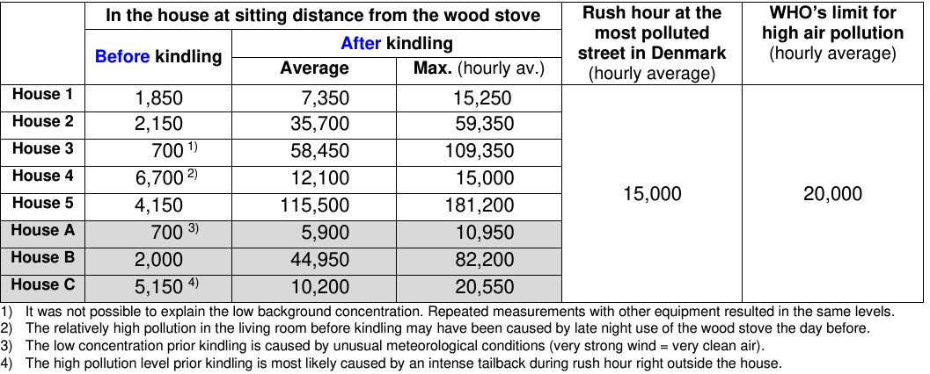
Five Danish homes

Slide 15
Residential wood burning
Dominant source to outdoor/indoor air pollution with fine particles (PM_{2.5}), black carbon (BC), PAHs, VOCs & dioxins.
Contributes significantly to morbidity, premature mortality, climate change (CO₂, BC, CH₄) and nature destruction.
New stoves and boilers might have lower PM_{2.5} emissions than old devices, but do not solve the pollution problem.
Firewood consumption (incl. illegal firewood) increases.

Slide 16
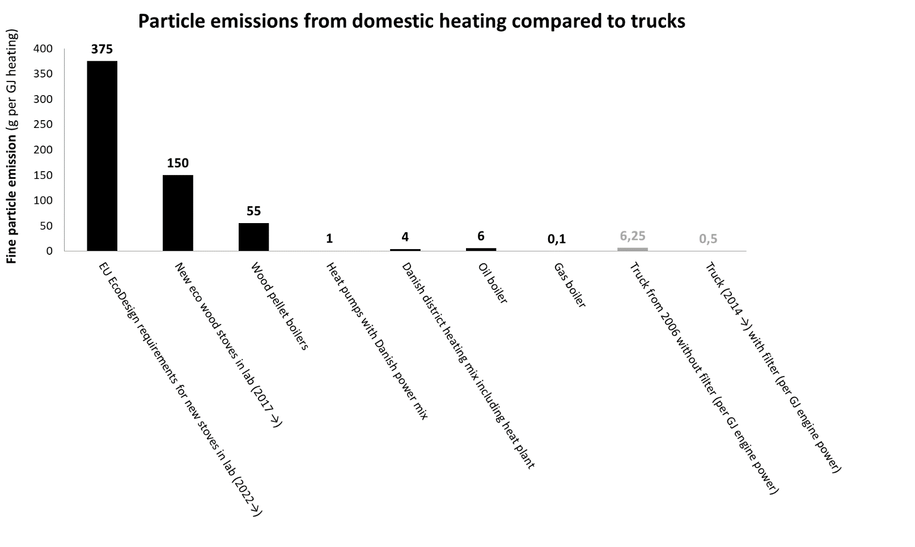
Very weak regulation …
An EcoDesign wood stove under optimal conditions in 2024 emits 750 times more particles than an older truck from 2014 …
Eco wood stoves are wood stoves with the Nordic Swan ecolabel.
Banned in most EU cities

Slide 17
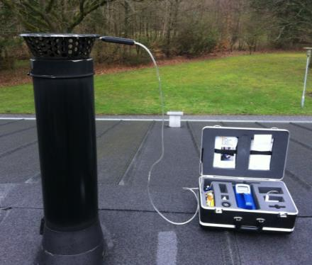
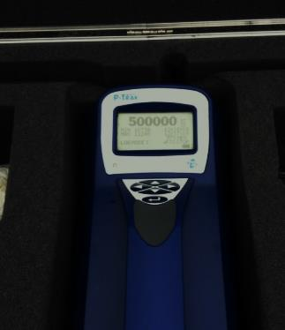
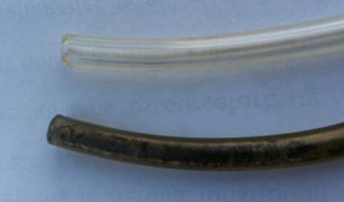
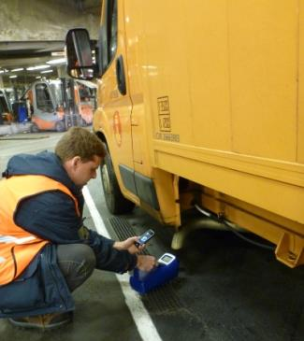
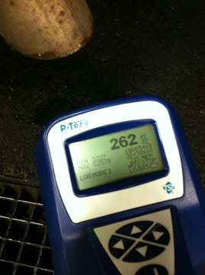
New stoves vs. new trucks
Top: Before stove measurements.
Below: After 1 h measurements.
Conclusion:
New low-emission stoves cause much higher emissions (above 500.000 part./cm³) than new trucks with particulate filters (below 1.000 part./cm³).

Slide 18
A simple calculation
A new wood stove fulfilling the EU EcoDesign regulation will (ideally) emit around 5 g PM_{2.5} pr. kg wood burned.
The new WHO guideline is 5 microgram PM_{2.5} per m³.
Burning 1 kg of wood will pollute (at least) 1,000,000 m³ of completely clean air to the air quality guideline ... All air covering 10,000 m² up to 100 m height!
This is not aligned with the EU zero pollution vision …

Slide 19
Wood burning in Copenhagen
The 15,000 wood stoves in Copenhagen emit more fine particles (PM_{2.5}) in one winter than all traffic in the capital emits in a full year!
Wood burning only covers around 0.3% of the total energy consumption but emits 37% of fine particles.
By replacing wood burning with district heating, the fine particle emission would be reduced more than if all traffic (all cars, trucks, etc.) was prohibited …

Slide 20
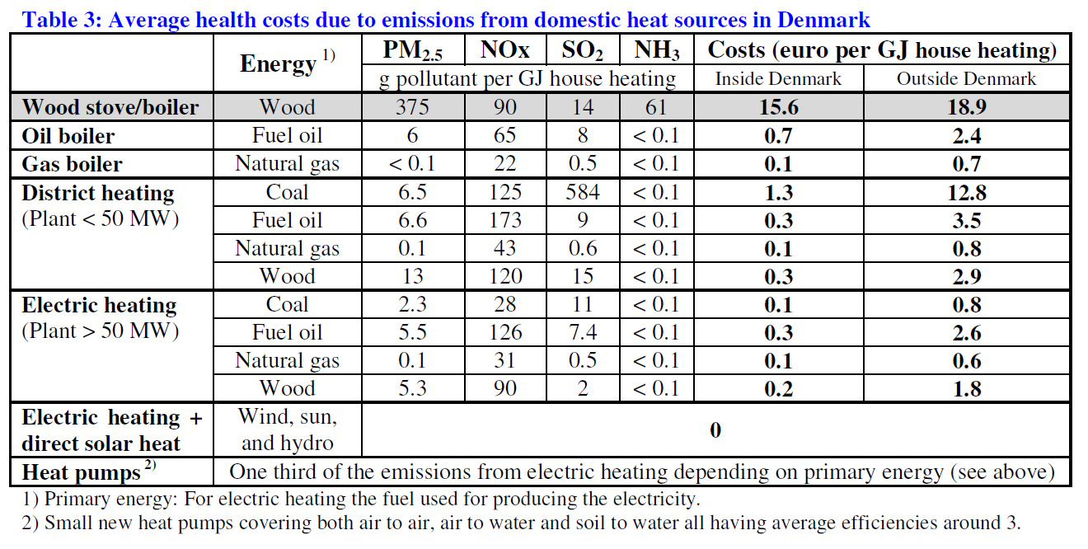
The most expensive heat

Slide 21
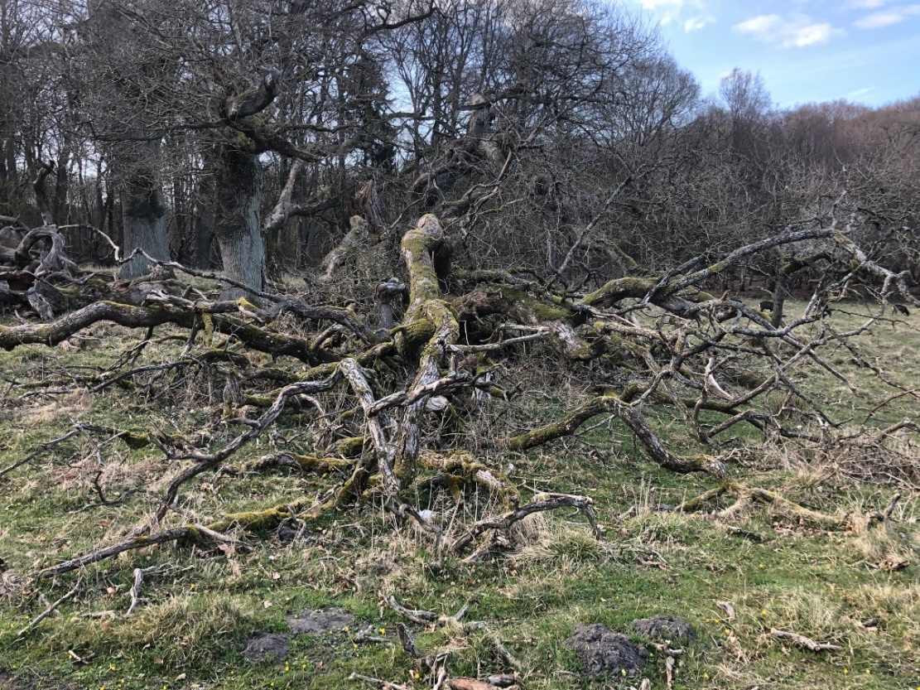
Dead trees = Biodiversity
A natural forest maintains a CO₂-equilibrium and is rich on biodiversity.
Trees die/decompose at the same rate as new trees grow.
The balance is destroyed when we start burning wood from the forest.

Slide 22
In dept to nature and climate
Half of all Danish species are connected to forests.
In our 10 types of forests, the ecosystem status is “strongly unfavourable” (Danish reporting to the EU).
This unfavourable condition of the forests is one of the key causes of nature’s deterioration in Denmark.
In particular, the absence of dead wood is one of the main causes of poor biodiversity (and poor CO₂-storage).
An average Danish forest: 5-6 m³ dead wood per ha.
Intact forest (Suserup Forest): 190 m³ dead wood per ha.

Slide 23
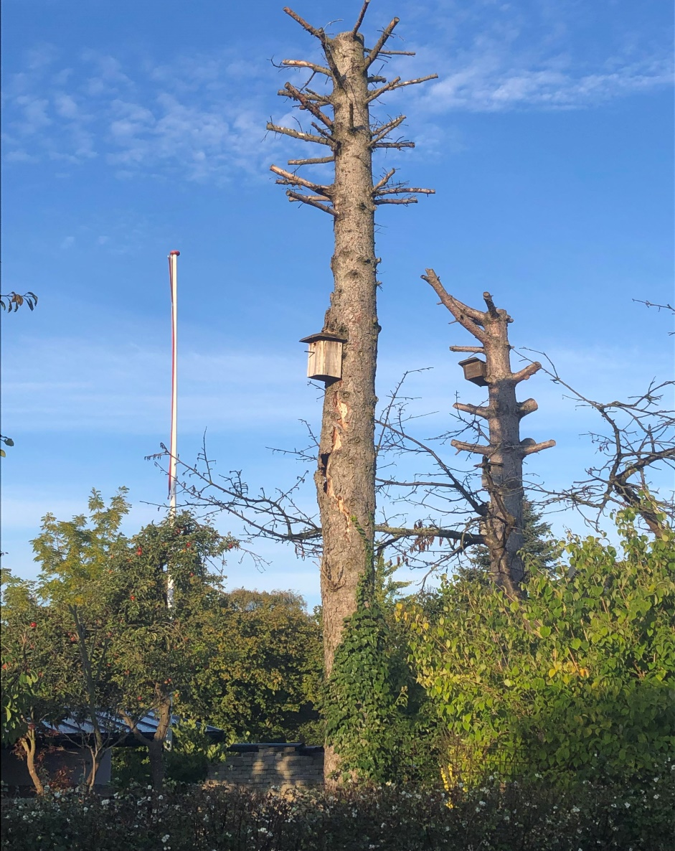
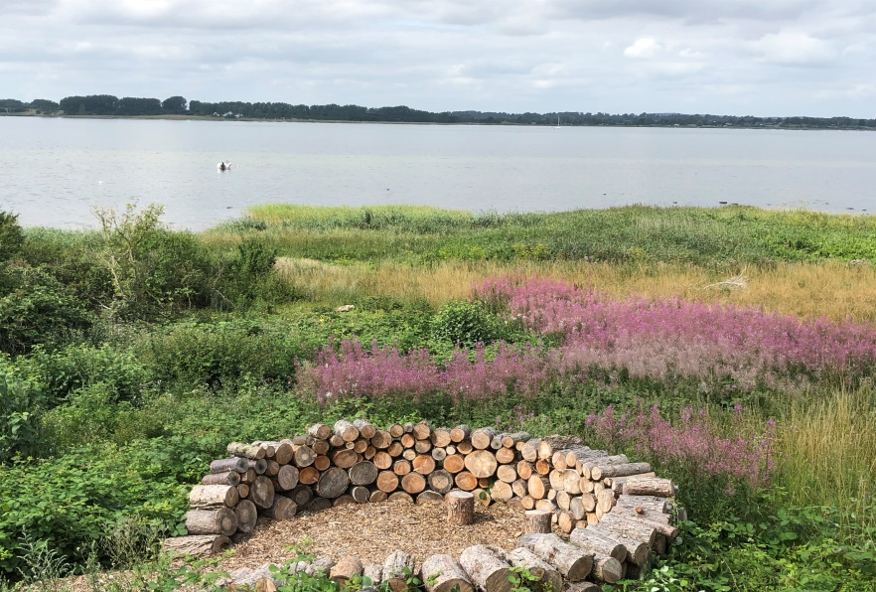
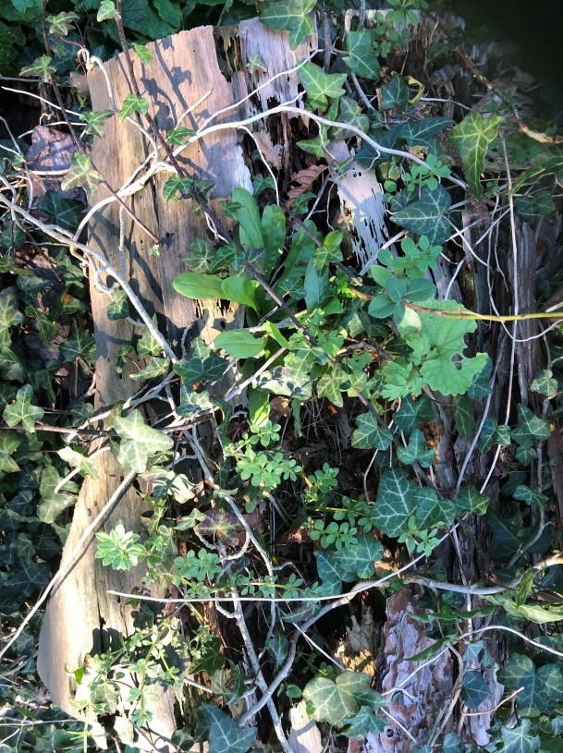
Stimulate biodiversity in your garden

Slide 24
Climate impact from wood burning
Coal: 95 kg CO₂ pr. GJ.
Wood: 115 kg CO₂ pr. GJ.
1 kg of CO₂ from wood causes the exact same global warming impact as 1 kg CO₂ from coal – our climate can’t tell the difference between the CO₂-molecules!
It’s just a political decision that wood is seen as CO₂-neutral … leading to coal and fossil energy being replaced by wood.

Slide 25
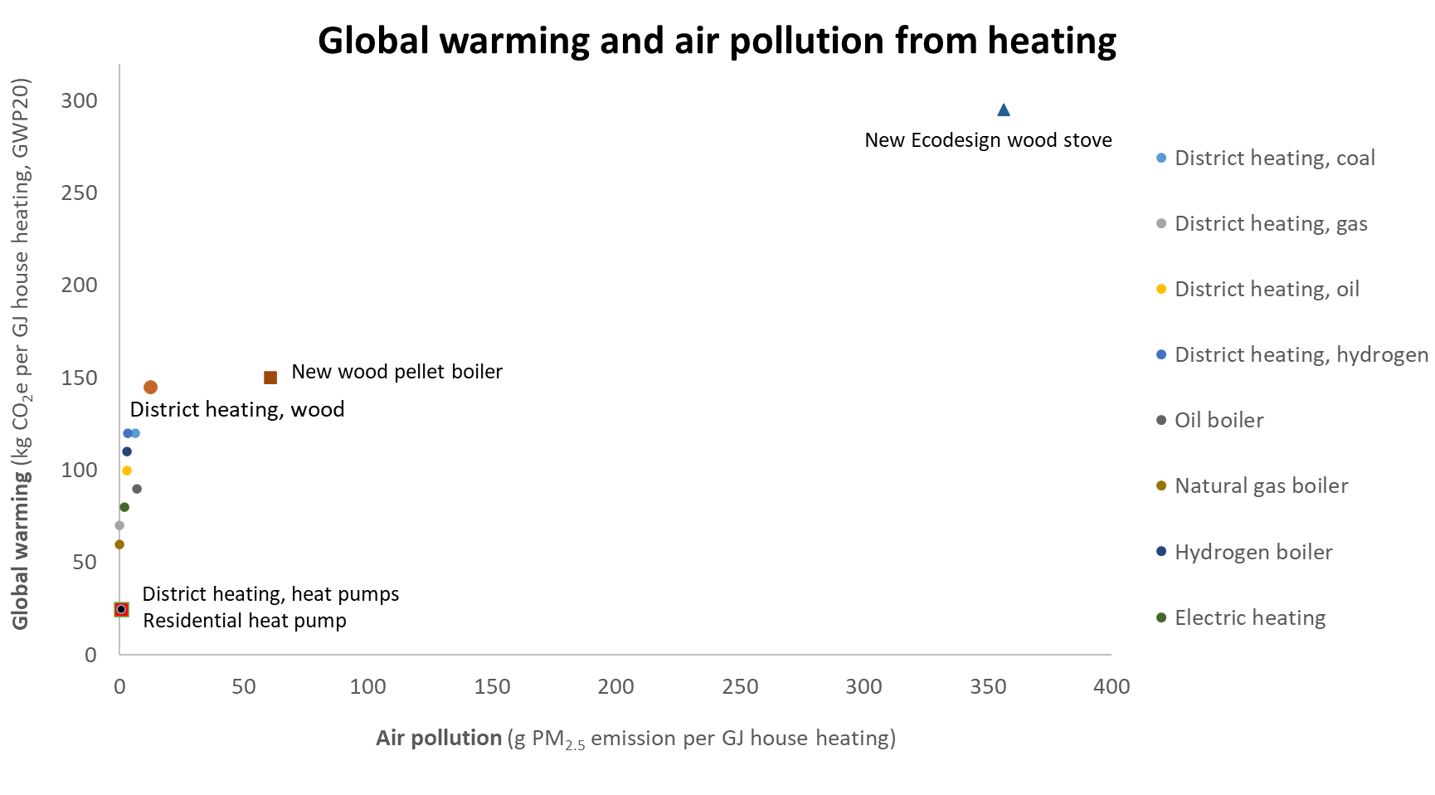
Ranking of heat sources
We need clean heat =
Smoke-free heat =
STOP burning

Slide 26
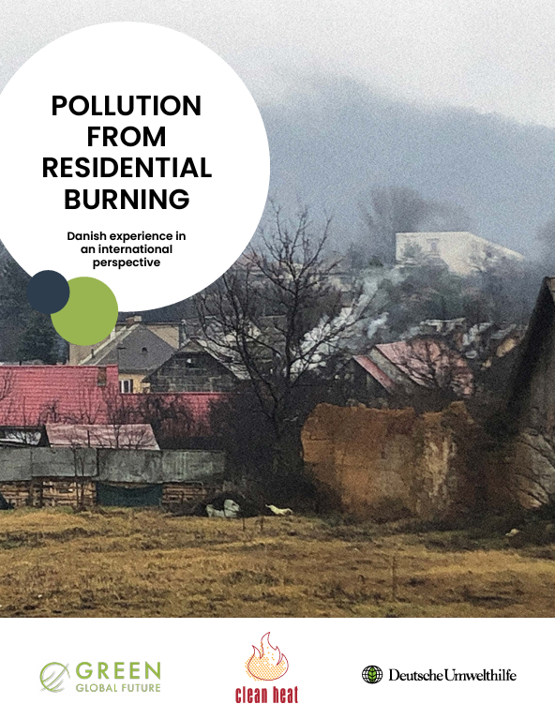
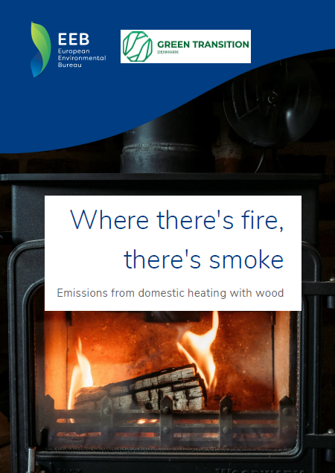
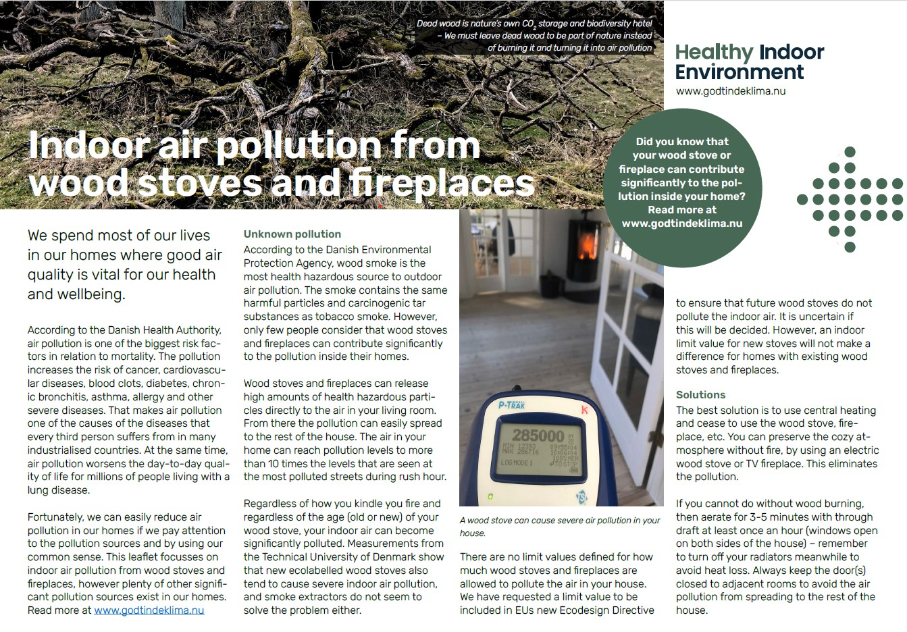
More information
HEIs campaign page on indoor air pollution from residential wood burning
GGFs publication on Pollution from residential wood burning
EEBs publikation: Where there’s fire, there’s smoke – Emissions from domestic heating with wood

